Slide 1


Ai Gym Coach
Assiut University
1/35

Slide 2
Table of Contents:
Team Member
Task description
Demo of the running application
Contribution
Data
Project architecture
Methods
Results
Assiut University
2/35

Slide 3
Team Member.
Assiut University
3/35

Slide 4
Team Member
38_Team
Khaled Ibrahem Al-Desouky ID 162021111
Khaled Ahmed Mohamed ID 162021113
Hassan Khaled Mohamed ID 162021104
4/35

Slide 5
2. Task description
Assiut University
5/35

Slide 6
Task description
The task involves developing an "AI Gym Coach" application that leverages computer vision and machine learning techniques to assist users during their workout routines.
The application aims to provide real-time guidance and feedback on exercise form and technique, helping users optimize their workouts and achieve their fitness goals effectively.
The "AI Gym Coach" application utilizes the MediaPipe framework for pose detection and analysis, enabling it to track users' movements.
It offers personalized feedback and instructions based on the user's performance, ensuring proper form and technique for various exercises.
Assiut University
6/35

Slide 7
Key Components:
Pose Detection and Analysis
Voice Feedback Integration
User-Defined Workout Correctness
Workout Techniques Implementation
Assiut University
7/35

Slide 8
3. Demo of the running application
Assiut University
8/35

Slide 9

Demo
Assiut University
9/35

Slide 10
4. Contribution
Assiut University
10/35

Slide 11
Contribution
We enriched the code to support Ai Gym Coach:
This enhancement allows the AI Gym Coach to accurately detect and analyze body posture and movements in real-time, providing immediate feedback to ensure proper exercise form and technique. This advancement significantly enhances the workout experience by offering personalized guidance and reducing the risk of injury.
Voice Feedback upon Workout Completion
Implemented voice feedback functionality to provide real-time audio cues to the user upon completion of each workout session and upon finishing all scheduled workouts.
This feature enhances the user experience by providing auditory confirmation of progress and completion without the need to visually monitor the application interface constantly.
Assiut University
11/35

Slide 12
3. We've upgraded the AI Coach to analyze users' physical movements:
Allowing it to deliver personalized feedback on workout execution.
This enhancement empowers users to refine their form and technique, optimizing their fitness journey with tailored guidance and support.
4. Flexible Training and Immediate Exercise Evaluation
We developed a flexible and adaptive model for exercise classification, particularly for triceps exercises.
Users can collect and label their own data, making the model highly customizable.
The straightforward training process allows adjustments to the model architecture and parameters.
The system provides real-time feedback on exercise correctness based on the training data, helping users correct their form immediately.
Assiut University
12/35

Slide 13
5. Error Analysis:
Despite achieving an impressive test accuracy of 92%, the model still misclassifies 8% of the test samples. Conducting an error analysis helps to understand and address these misclassifications. Here are the steps taken to perform the error analysis:
Identification of Misclassified Samples:
The test set predictions were compared with the true labels to identify misclassified samples.
The indices of these misclassified samples were recorded for further inspection.
Assiut University
13/35

Slide 14
Visualization of Misclassified Samples:
For each misclassified sample, the corresponding pose landmarks were plotted.
Visualization helps to understand the context and specific scenarios where the model fails.
3. Pattern Analysis in Misclassified Samples:
By inspecting the visualizations, common patterns or characteristics in the misclassified samples were identified.
These may include issues like partial occlusion, unusual poses, or poor lighting conditions that could affect the model’s performance.
Assiut University
14/35

Slide 15
4. Model Confidence Analysis:
The confidence scores of the model’s predictions were examined.
Lower confidence scores on misclassified samples indicated uncertainty and highlighted areas where the model struggles.
Categorization of Errors:
Errors were categorized to understand if they were due to specific types of poses, movements, or environmental factors.
For example, misclassifications were more frequent when the subject's triceps were not clearly visible or when there was significant motion blur.
Assiut University
15/35

Slide 16
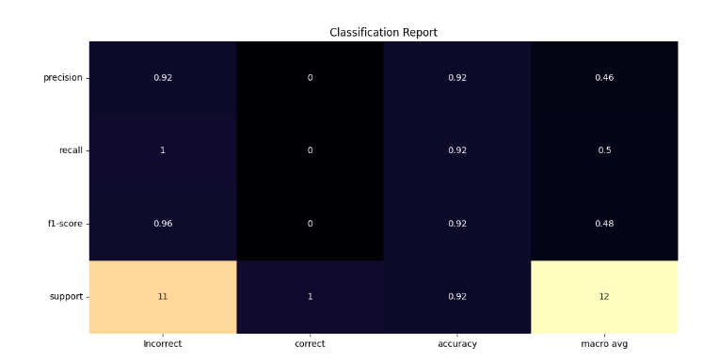
Figure 1. Classification Report
Assiut University
16/35

Slide 17
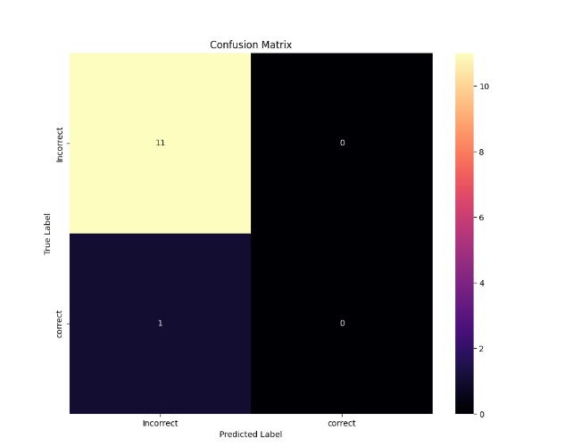
Figure 2. Confusion Matrix
Assiut University
17/35

Slide 18
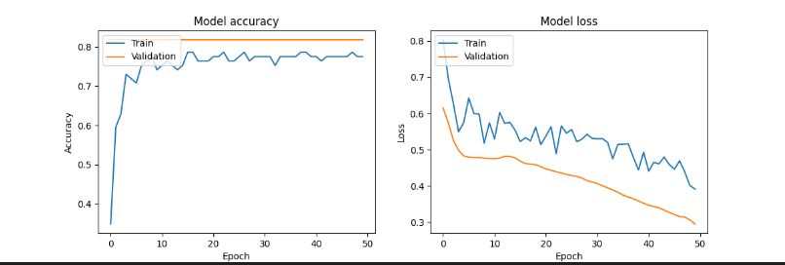
Figure 3. Model Accuracy and Model Loss
Assiut University
18/35

Slide 19
5. Data
Assiut University
19/35

Slide 20
Data
Shape and Size
Shape:
Each row contains 1 label + 33 landmarks * 4 values (x, y, z, visibility) + 1 timestamp = 134 columns.
If n frames are recorded, there will be n data rows plus 1 header row.
Size:
The size of the file depends on the number of frames captured.
For each frame, 134 values are written.
If you record 100 frames, the CSV file will have 101 rows (1 header row + 100 data rows), and each row will contain 134 values.
Assiut University
20/35

Slide 21
Source:
Projects_Computer_Vision/Gym Ai Coach (Mediapipe)/38_Code/triceps_data.csv at main · uukh22/Projects_Computer_Vision (github.com)
Example:
Figure 4. in the Collect Data.
Figure 5. correct in the Real Time.
Figure 6. Incorrect in the Real Time.
Assiut University
21/35

Slide 22
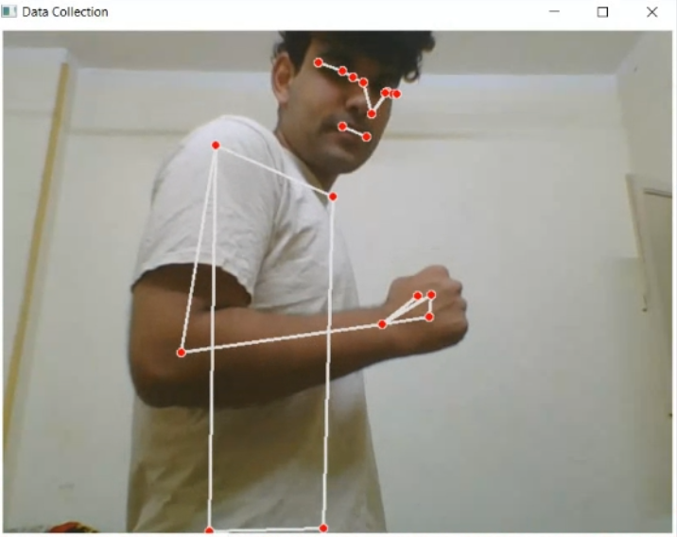
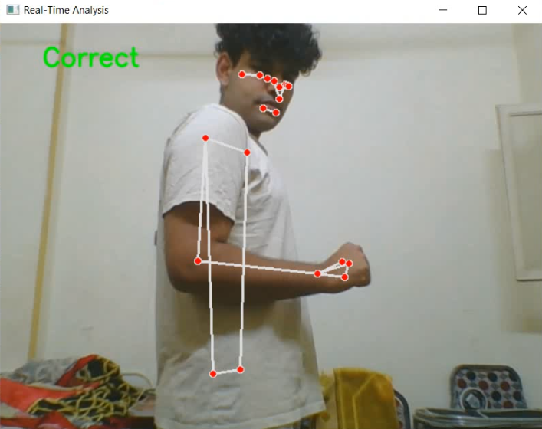
Figure 4. in the Collect Data.
Figure 5. Correct in the Real Time.
Assiut University
22/35

Slide 23
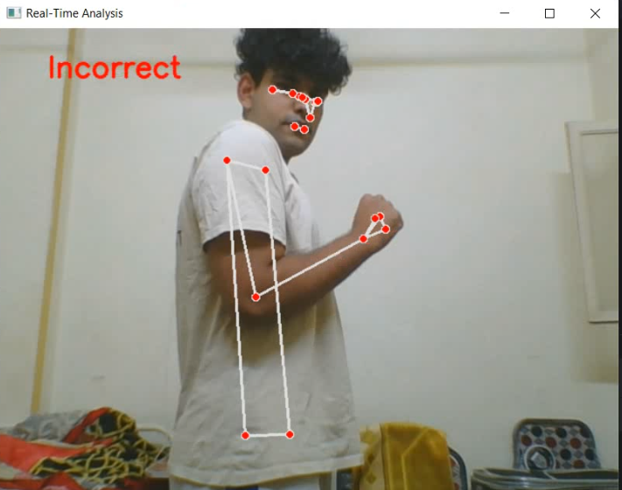
Figure 6. Incorrect in Real Time.
Assiut University
23/35

Slide 24
6. Project architecture
Assiut University
24/35

Slide 25
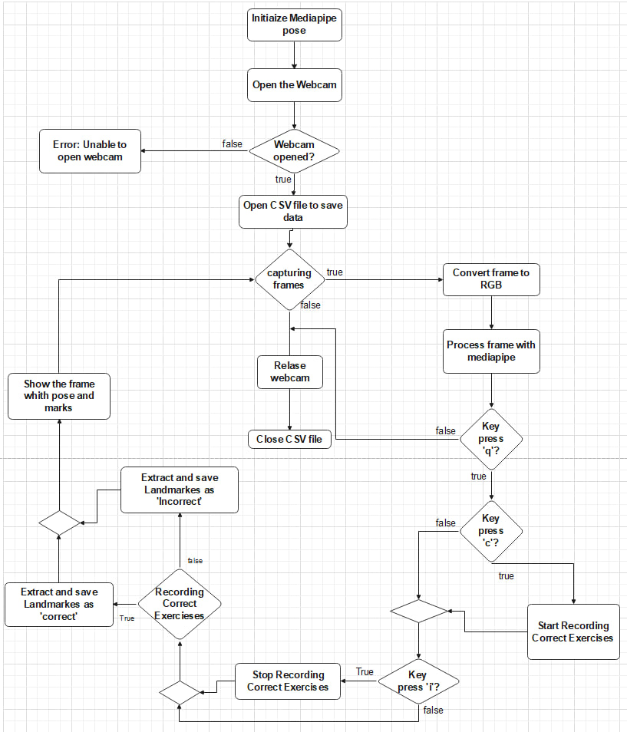
Project architecture
1. Collect Data in figure 6.
Figure 7. Flowchart to explain how model collect data
Assiut University
25/35

Slide 26
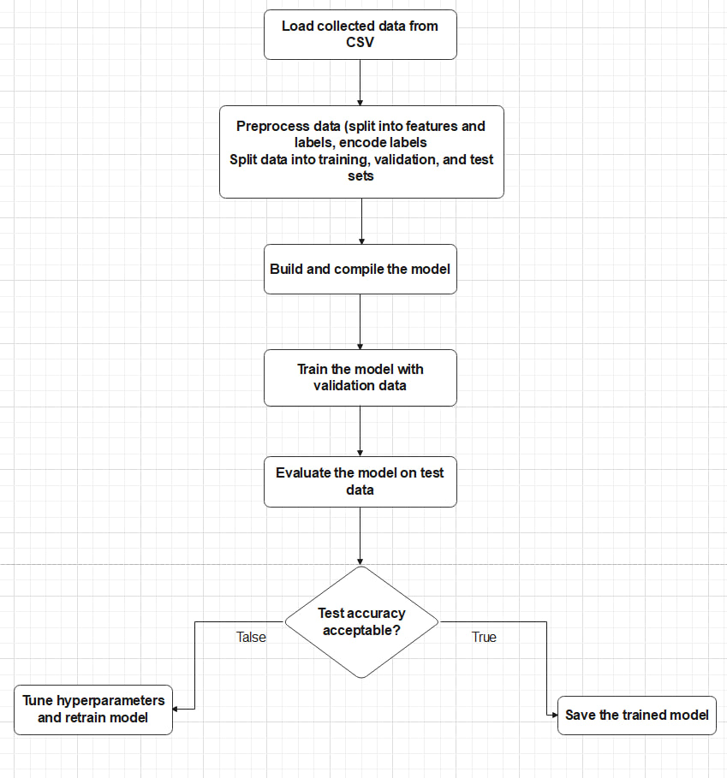
2. Model Training in Figure 7.
Figure 8. Flowchart to explain how model training.
Assiut University
26/35

Slide 27
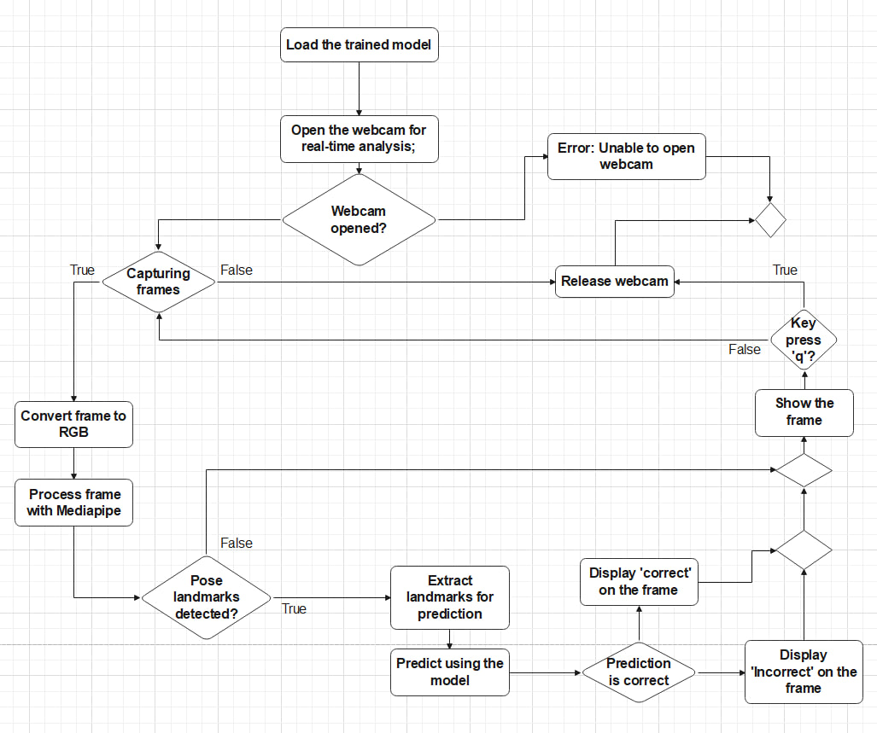
3. Real Time in Figure 8.
Figure 9. Flowchart to explain how model Real-time.
Assiut University
27/35

Slide 28
7. Methods
Assiut University
28/35

Slide 29
Methods
Mediapipe Pose Model:
Description:
Mediapipe Pose is a real-time pose estimation model that detects 33 key landmarks on the human body. It is highly efficient and accurate, making it suitable for applications such as fitness tracking and motion analysis. It's a supervised learning model used for classification tasks.
Assiut University
29/35

Slide 30
Usage in Code:
Initialization: mp_pose = mp.solutions.pose.
Pose Detection: pose = mp_pose.Pose().
Processing Frames: Converts frames to RGB and processes them to extract pose landmarks: results = pose.process(rgb_frame).
landmarks on frames using: mp.solutions.drawing_utils.draw_landmarks(frame, results.pose_landmarks, mp_pose.POSE_CONNECTIONS)
Drawing Landmarks: Visualizes the landmarks on frames
Assiut University
30/35

Slide 31
2. Custom Neural Network Model (Using TensorFlow and Keras):
Description:
A custom deep learning model designed to classify exercises as 'correct' or 'incorrect' based on pose landmarks.
The model includes dense layers, batch normalization, and dropout layers to improve performance and prevent overfitting.
Assiut University
31/35

Slide 32
Architecture:
Input Layer: Accepts the pose landmarks as input features.
Hidden Layers:
First Layer: 128 neurons with ReLU activation, followed by batch normalization and a dropout layer.
Second Layer: 64 neurons with ReLU activation, followed by batch normalization and a dropout layer.
Third Layer: 32 neurons with ReLU activation, followed by batch normalization and a dropout layer.
Output Layer: A single neuron with a sigmoid activation function for binary classification.
Assiut University
32/35

Slide 33
8. Results
Assiut University
33/35

Slide 34
Results
Training Phase :
Training Loss: 37%
Training Accuracy: 77%
Testing Phase :
Test Loss: 30%
Test Accuracy: 92%
Assiut University
34/35

Slide 35
Thank You

